Slide 1
Fundamentals and Methods of Computer Science
Exercise week 4

Slide 2
Today’s Menu
Discussion of assignment 3 and the respective quiz
More details about this semester’s group project
Brief summary of skills necessary to solve assignment 4
Working on assignment 4

Slide 3
Discussion of assignment 3 and the respective quiz

Slide 4
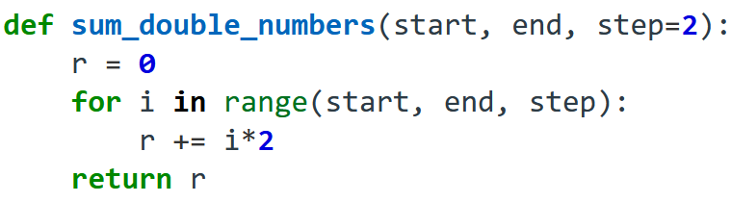
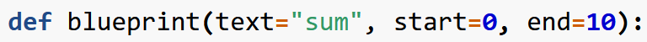
Assignment 3 & Quiz 3: What the questions were about
# Positional argument – parameter mapping
# Remember keyword argument-param mapping
def function_name(variable_name):
a = "some string" + variable_name
# no return = implicitly None returned
return a
x = function_name("ABC")
-------------------------------------------
# Remember default parameters
def function_name(variable_name="ABC"):
a = "some string" + variable_name
return a
x = function_name()
Defining & calling functions
Lists & .append() method
Sets are unique!
Iterable methods: sorted, reversed, …
Indexing
print(‘Hello World’)
Hello World
print(‘Hello’, ‘World’)
Hello World
x = 5
y = 6
print(x + y)
11
print(‘The result of x + y is’, x + y)
→ The result of x + y is 11

Slide 5
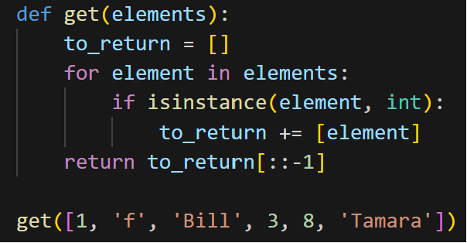
Assignment 3 & Quiz 3: What the questions were about
Defining & calling functions
Lists & .append() method
Sets are unique!
Iterable methods: sorted, reversed, …
Indexing
# Create an empty list
empty_list = []
# Assignment by reference
new_list = empty_list
# Add a value to the end of the list
#(think of list as underlying of variable)
new_list.append(123) # similar to +=
# += creates new obj.
# Both lists are now changed
print(empty_list)
print(new_list)

Slide 6
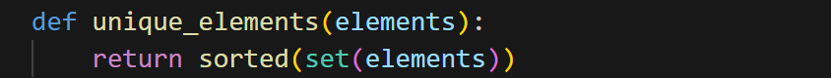
Assignment 3 & Quiz 3: What the questions were about
Defining & calling functions
Lists & .append() method
Sets are unique!
Iterable methods: sorted, reversed, …
Indexing

Slide 7
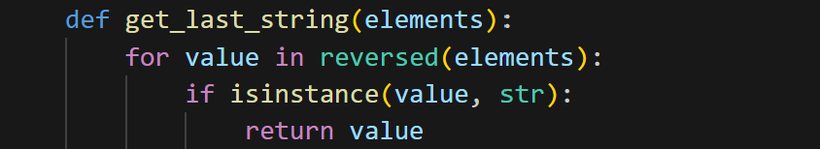
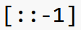
Assignment 3 & Quiz 3: What the questions were about
Defining & calling functions
Lists & .append() method
Sets are unique!
Iterable methods: sorted, reversed, …
Indexing
Note this function!

Slide 8
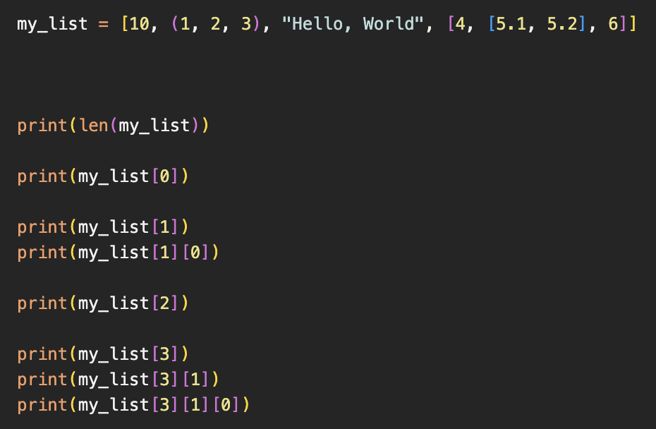
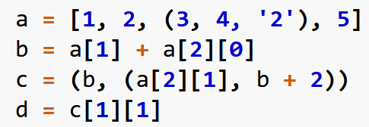
Assignment 3 & Quiz 3: What the questions were about
Defining & calling functions
Lists & .append() method
Sets are unique!
Iterable methods: sorted, reversed, …
Indexing
index:
0
1
2
3
> 4
> 10
> (1, 2, 3)
> 1
> “Hello, World”
> [4, [5.1, 5.2], 6]
> [5.1, 5.2]
> 5.1

Slide 9
Group project: Streamlit

Slide 10
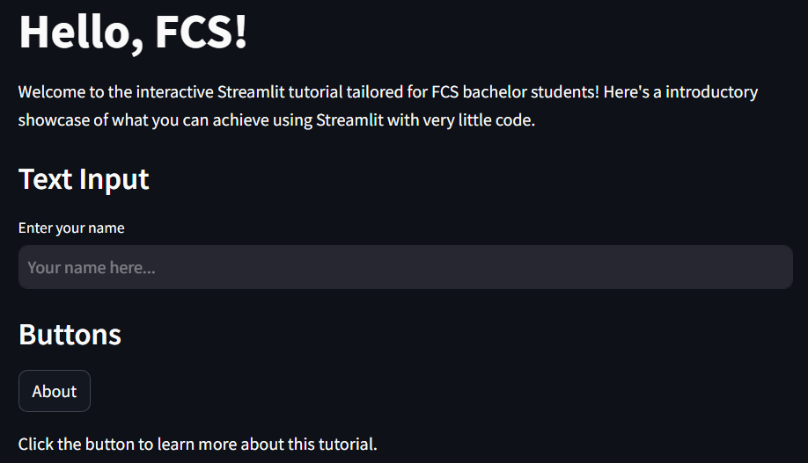
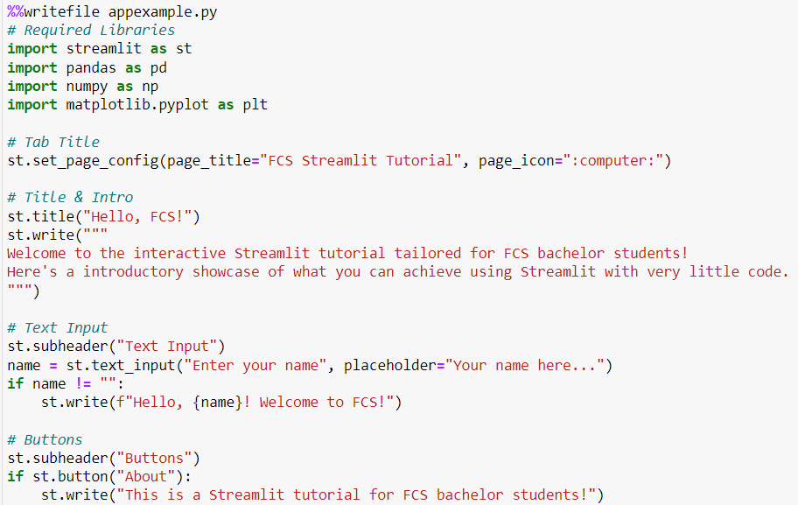
Streamlit – Let’s begin with a demo
Thanks, Streamlit!

Slide 11
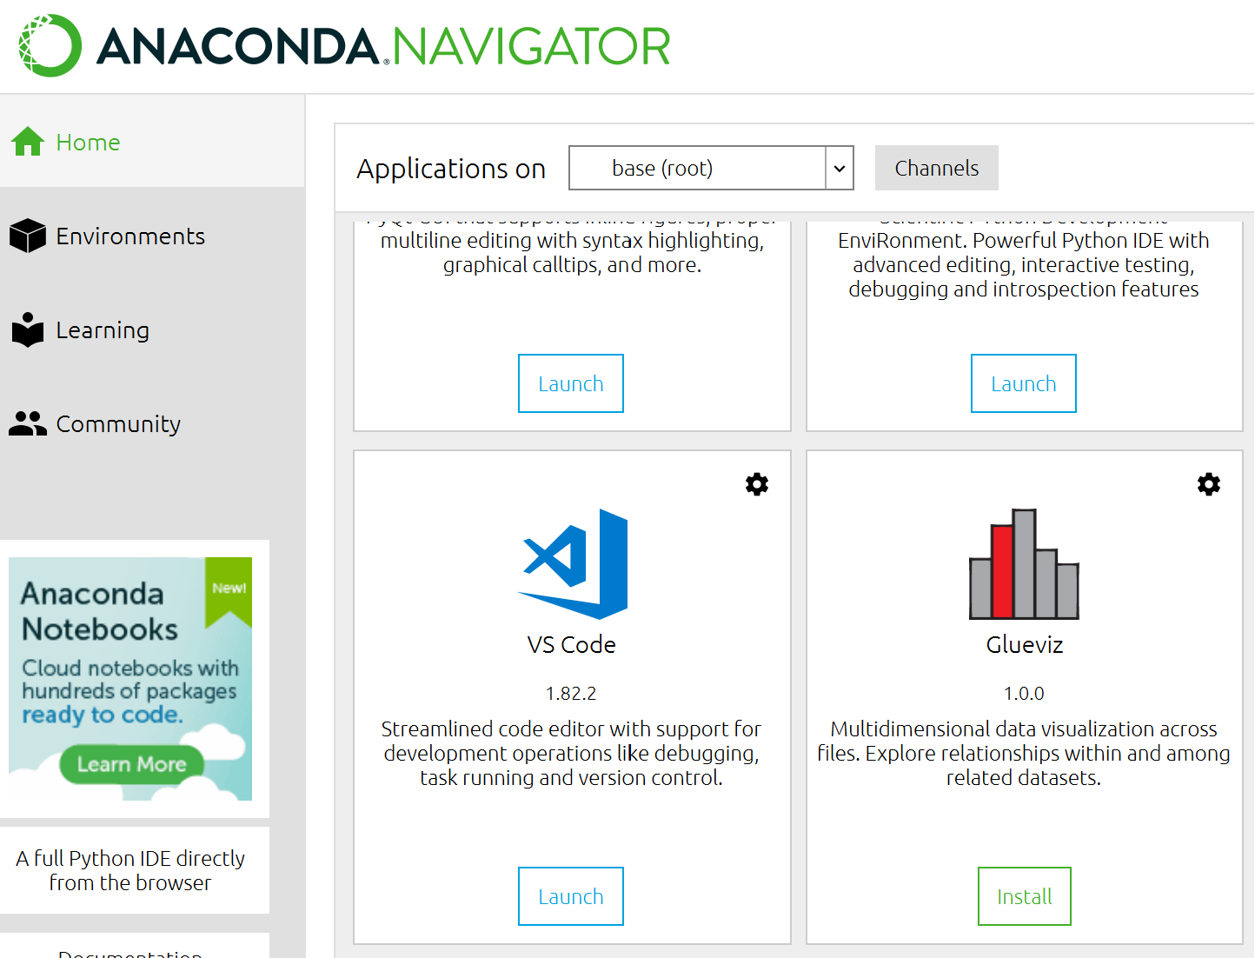
Streamlit – step-by-step
1
Install a text editor

Slide 12
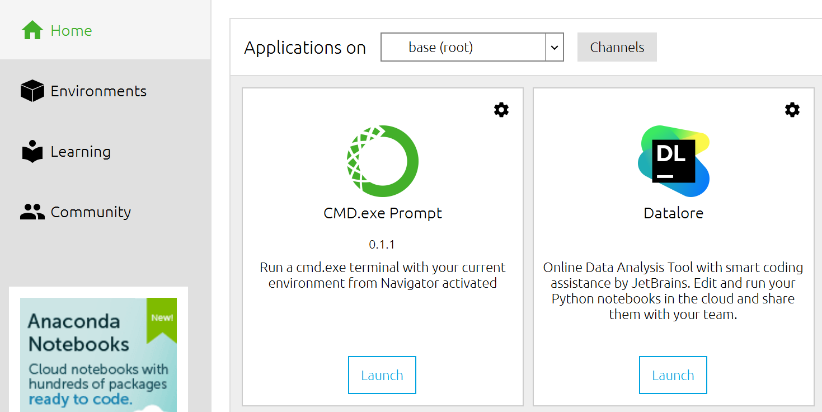


Streamlit – step-by-step
2
Open Anaconda commandline
Install streamlit:
pip install streamlit
Keep that command in mind, you will use it more often to install packages that you need!

Slide 13



Streamlit – step-by-step
3
Try streamlit example
When asked for email, just hit enter → should open in Browser!
Stop execution of a Python program with CTRL+C.
Overview of current folder with dir (Mac: use ls)
Navigate to subfolder with cd subfolderName (start typing & hit TAB)
Navigate one folder up with cd ..
Repeat last command with UP / DOWN
Navigate to the lecture example and execute it with streamlit run …
Navigate to the lecture example and try those
Note: You could also execute it with full path (starting from current location)

Slide 14
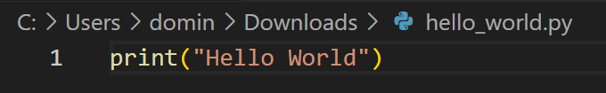
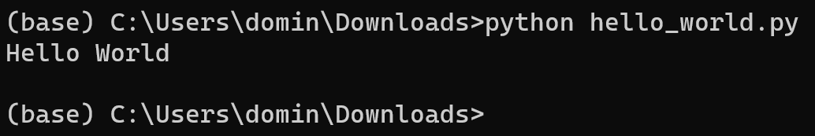
Streamlit – step-by-step
4
Open your text editor
Store your text file with the .py extension
Try a basic «Hello World» file

Slide 15
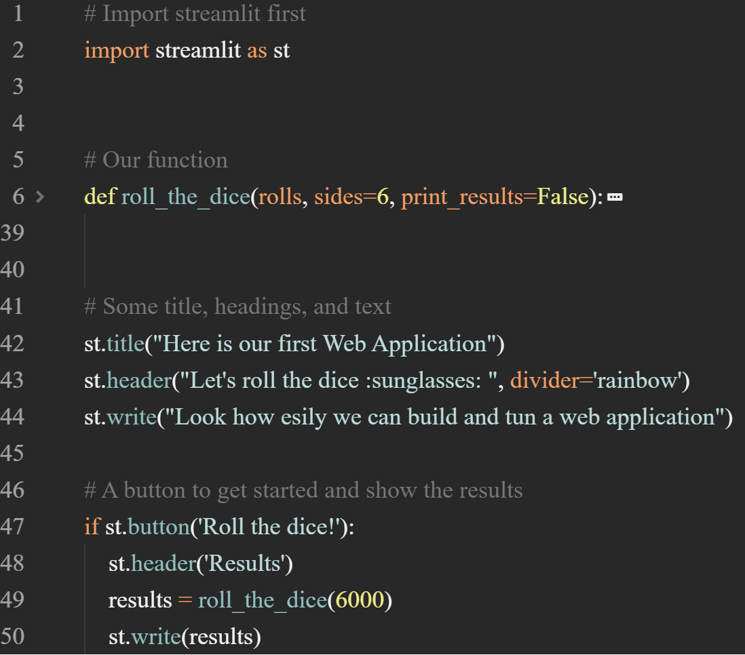
Streamlit – step-by-step
Example App: https://fcs-intro.streamlit.app/
Corresponding Code: https://github.com/hawk-li/fcs-streamlit-intro/blob/main/app.py
Bonus Example: https://github.com/hawk-li/fcs-streamlit-auto-doc-ipynb/tree/main
5
Play around with streamlit

Slide 16
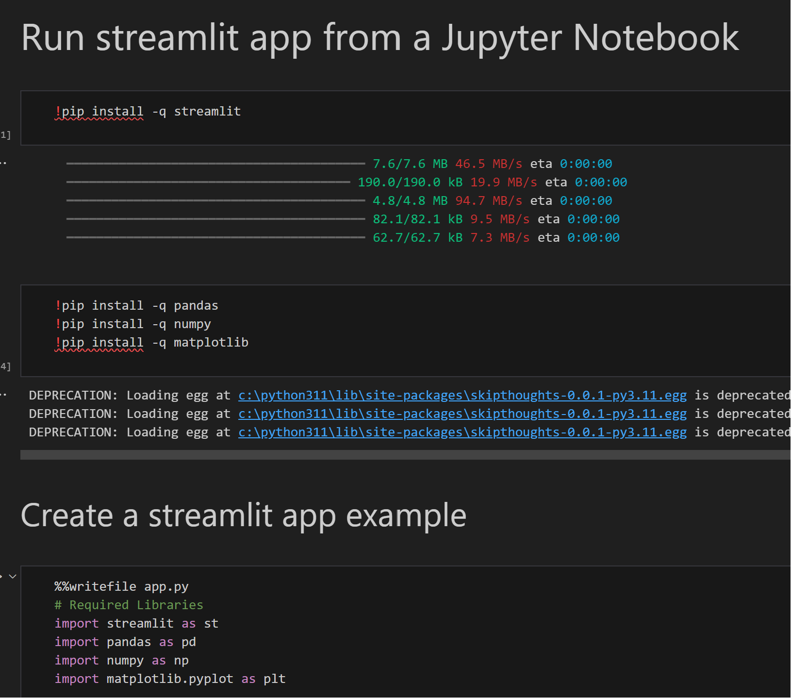
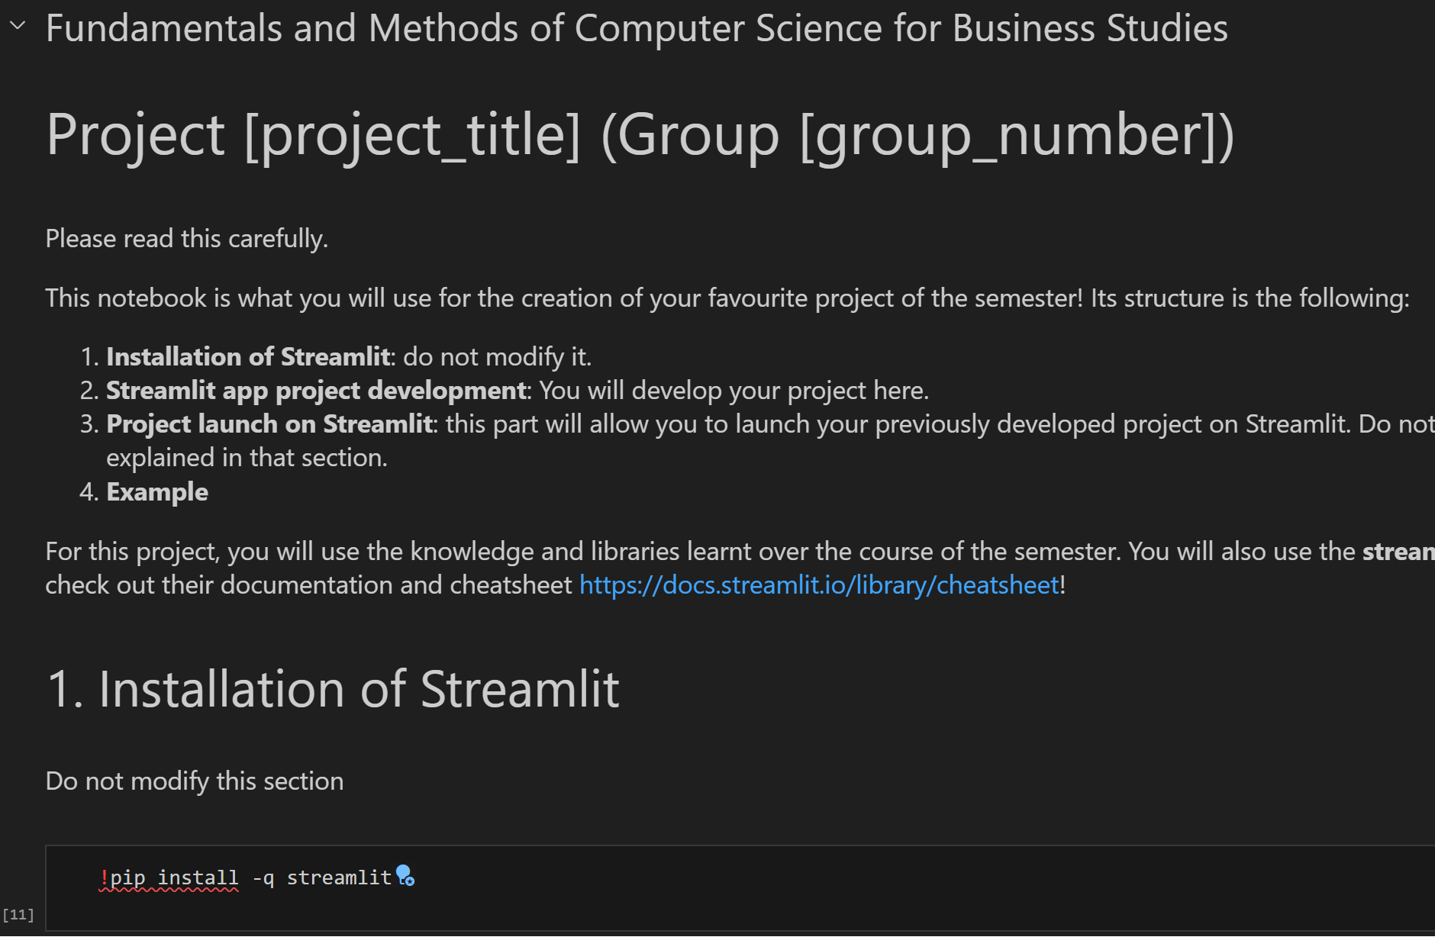
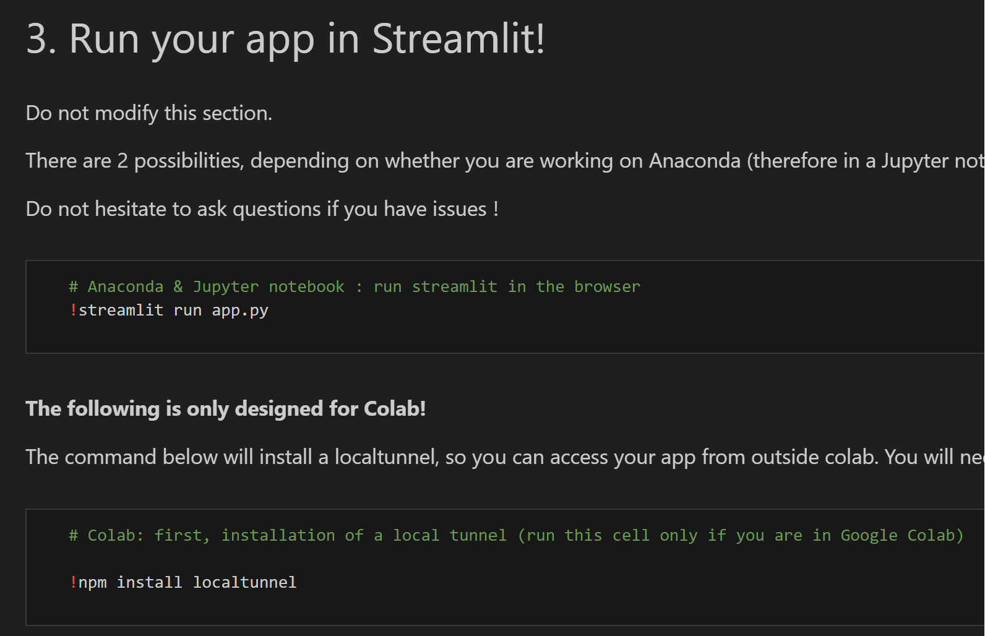
Streamlit – note
Also: Don’t worry about virtual environments, you will code everything in the main environment. If you see conda create / conda activate / … you may ignore that.
If you see one of these, from your friends etc., don’t bother. It is possible to code, store & execute the streamlit app from a Jupyter Notebook. However, this is just using special Jupyter functionality to do the same you can: use pip install, store .py files (which is what you need to hand in at the end) & execute streamlit run in the command line. Thus, there are 0.0 reasons to use such notebooks and I don’t want to distribute them.

Slide 17
Brief summary of skills necessary to solve assignment 4

Slide 18
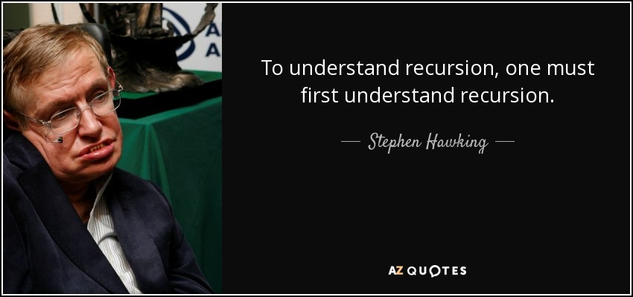


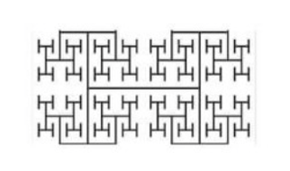

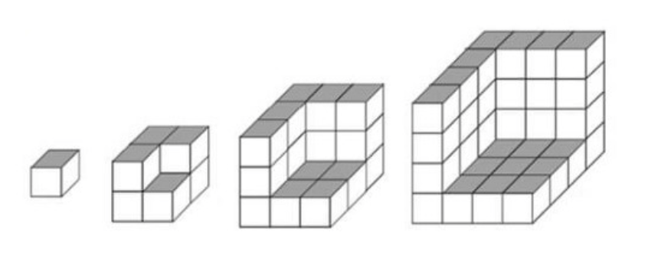
What is Recursion? (1/3)

Slide 19
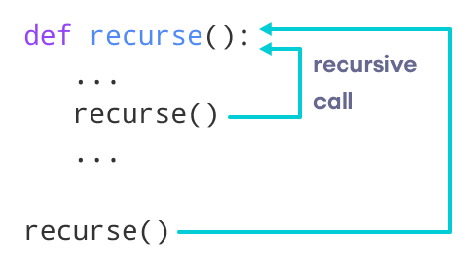
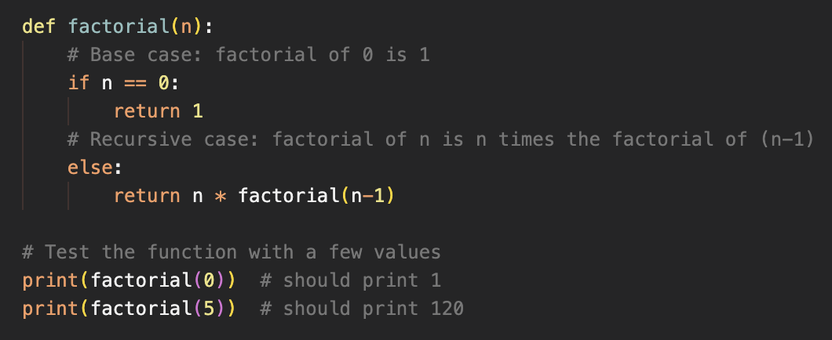
What is Recursion? (2/3)
A recursive function calls itself inside the defined function with new input until it reaches a base case
Recursion is powerful but requires careful design and can be difficult to debug.
Logic: The simplest base case (i.e., stop condition – here: if x == 1) is defined, everything else is calculated recursively by calling itself again (“self reference”)
Easy example: Finding the factorial of a number (i.e., 6! = ?)

Slide 20
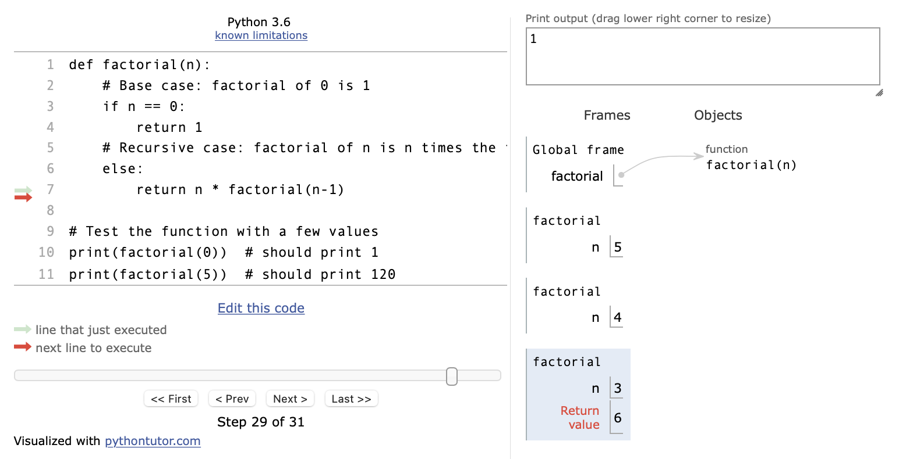

What is Recursion? 3/3
Recursion (3/3)
# All of you should be able to calculate
# the factorial like this. But there is
# an easier way: Recursion
factorial = 1
for number in range(5, 0, -1):
factorial *= number
def factorial(n):
# Base case: factorial of 0 is 1
if n == 0:
return 1
# Recursive case: factorial of n is n times the factorial of (n-1)
else:
return n * factorial(n-1)
# Test the function with a few values
print(factorial(0)) # should print 1
print(factorial(5)) # should print 120
BASE CASE / Stopping Condition
Try it out: https://pythontutor.com/python-debugger.html#mode=edit

Slide 21
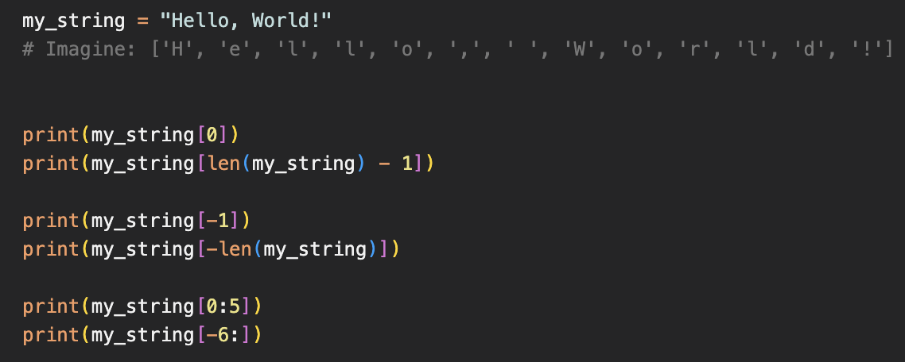
Indexing
(Nested) indexing
Negative indexing + Range indexing
index:
0
1
2
3
> “H”
> 4
> “!”
> “!”
> 10
> “H”
> (1, 2, 3)
> “Hello”
> “World!”
> 1
> “Hello, World”
> [4, [5.1, 5.2], 6]
> [5.1, 5.2]
> 5.1

Slide 22
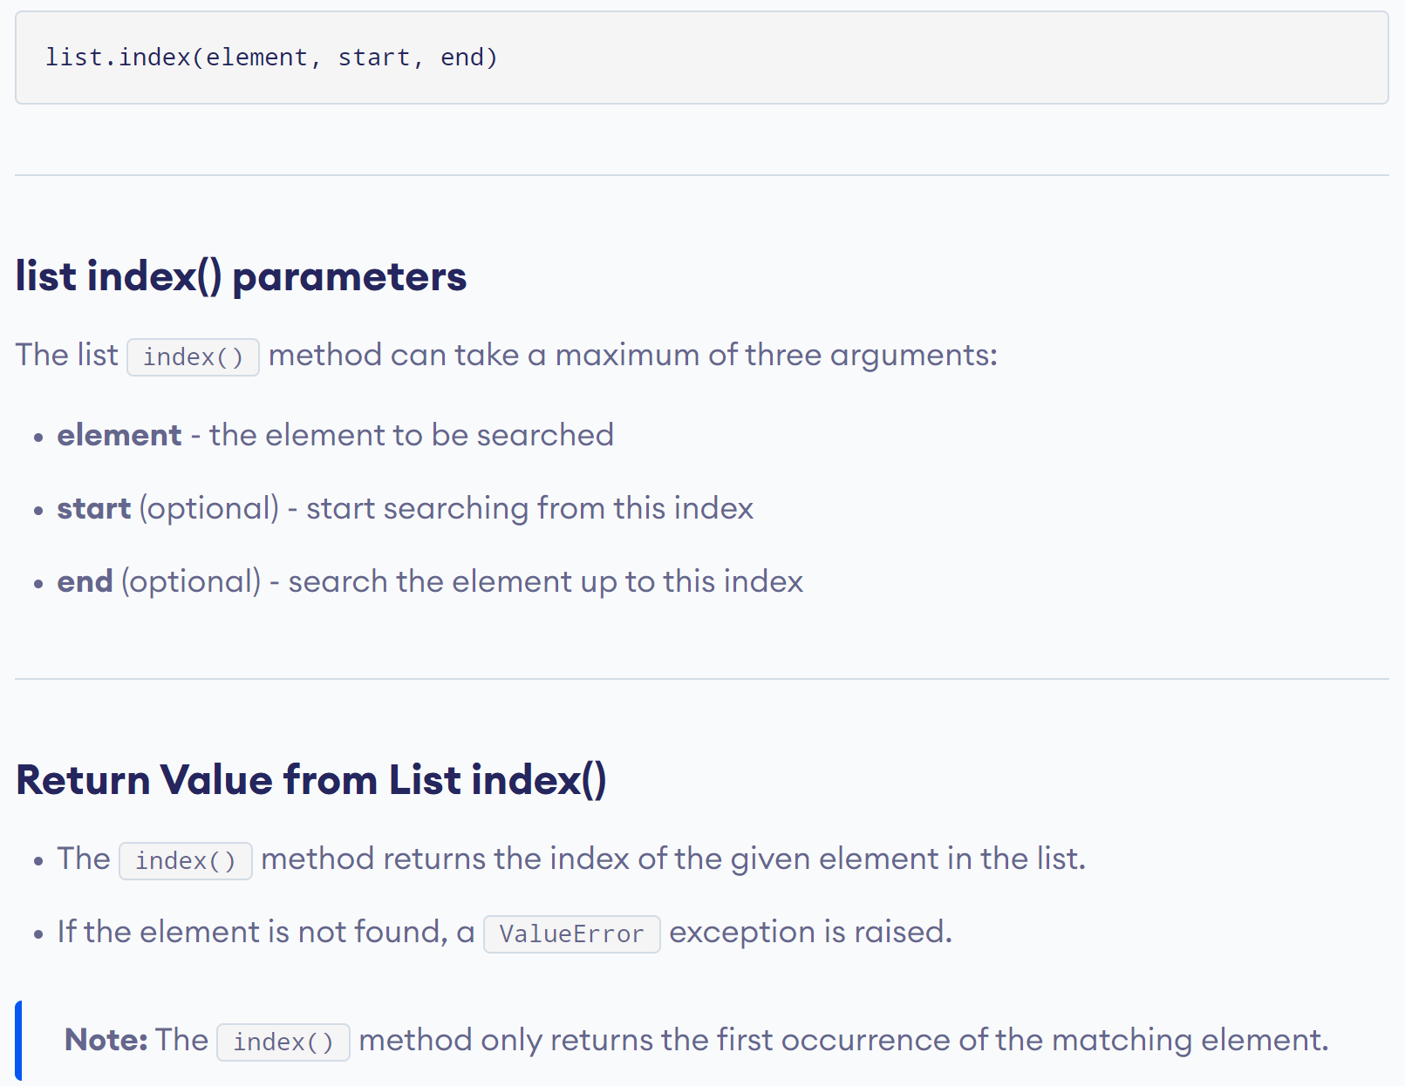
Python’s Built-In index() Function

Slide 23
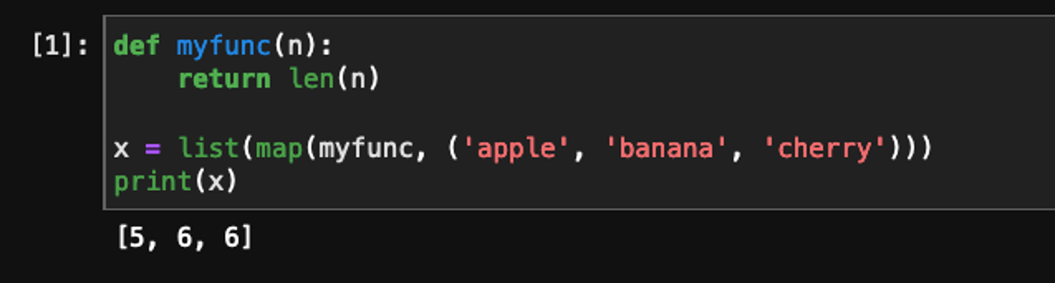
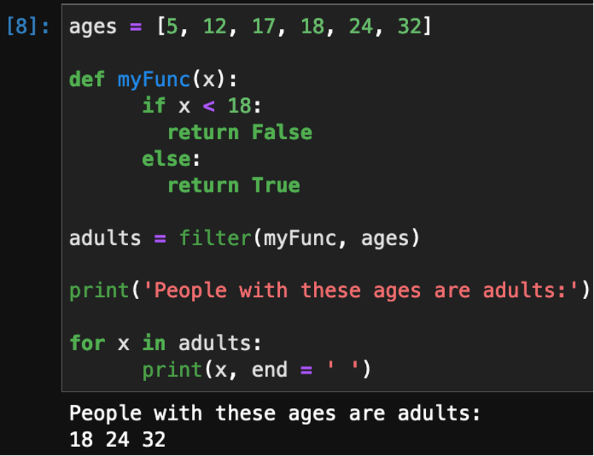
Map & Filter function
Map function
Filter function
Applies a function (here: myfunc(n)) on each element within a sequence (here: (“apple”, “banana”, “cherry”))
Filters out all elements from a sequence (here: ages) which meet the condition in the function (here: myFunc(x)), i.e., where myFunc(x) returns True).

Slide 24
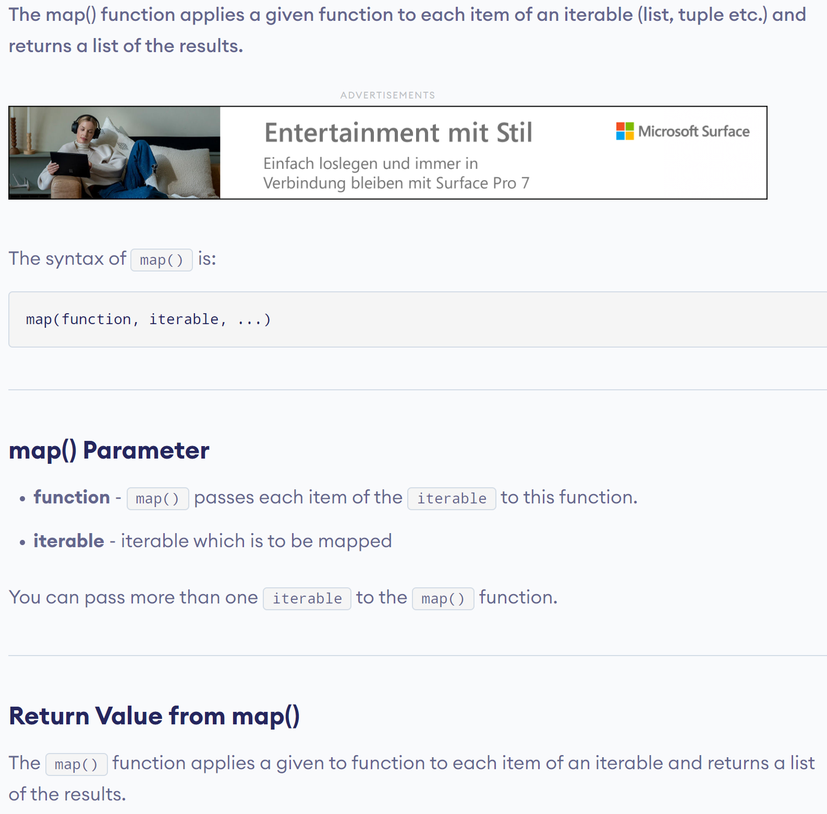
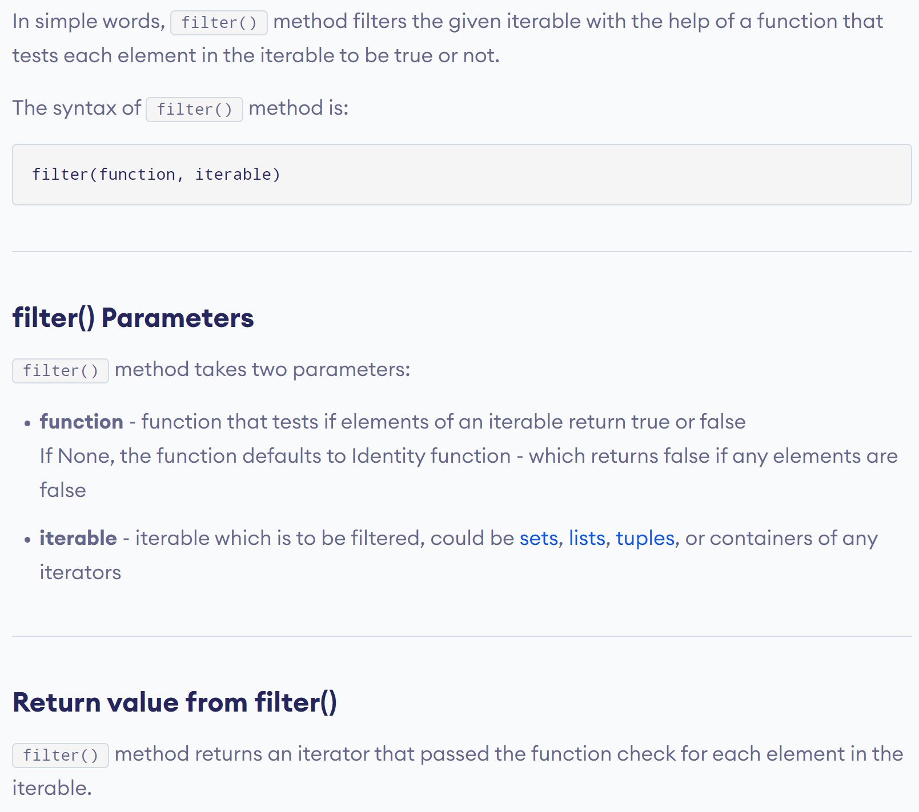
Python’s Built-in map() Function

Slide 25
Python’s Built-in filter() Function

Slide 26

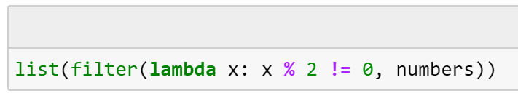
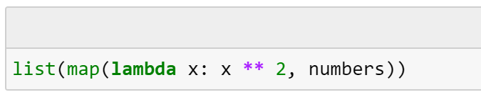
Using a lambda function instead of a defined function

Slide 27
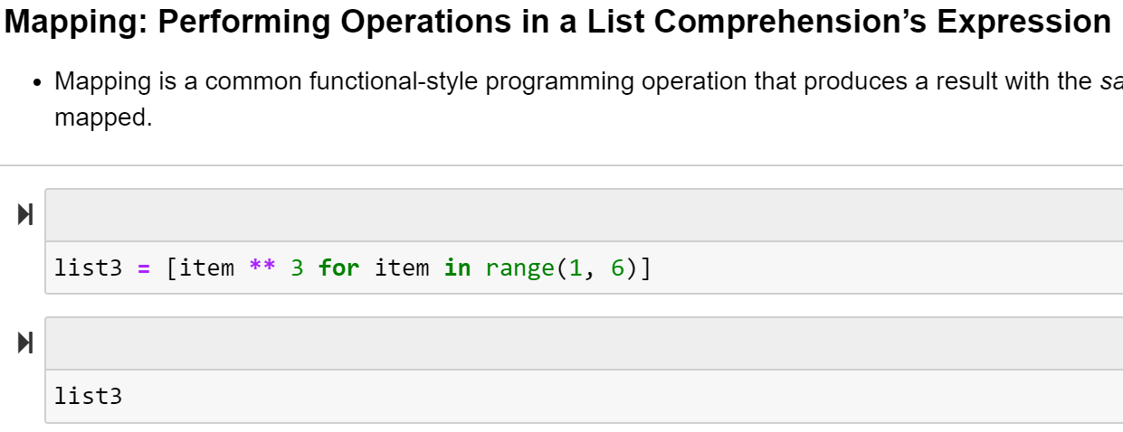
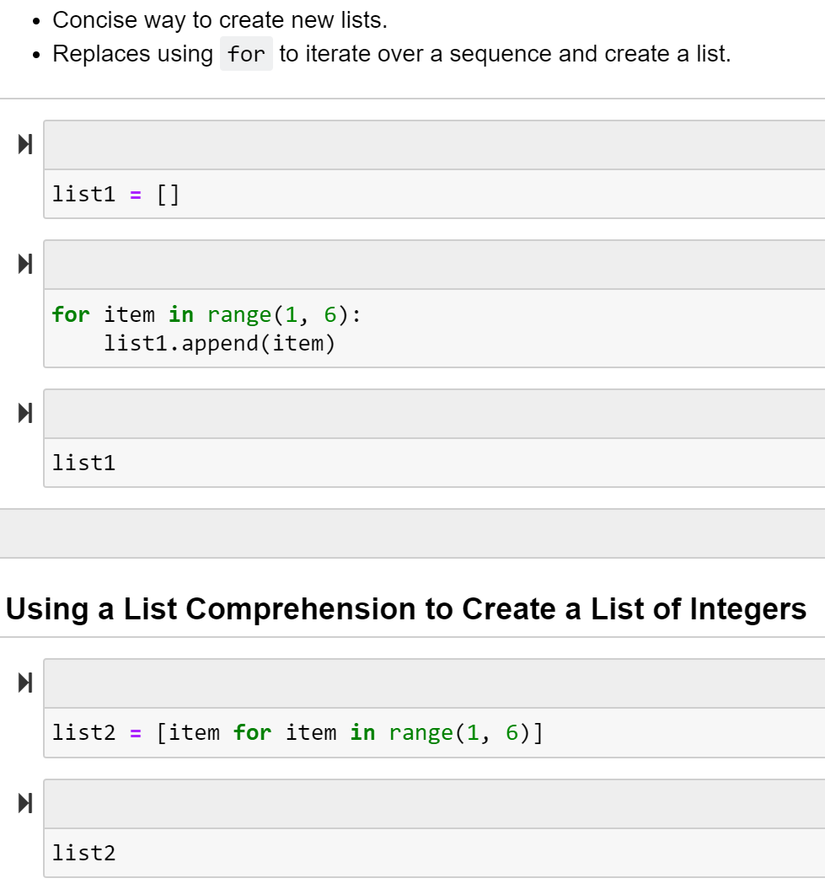
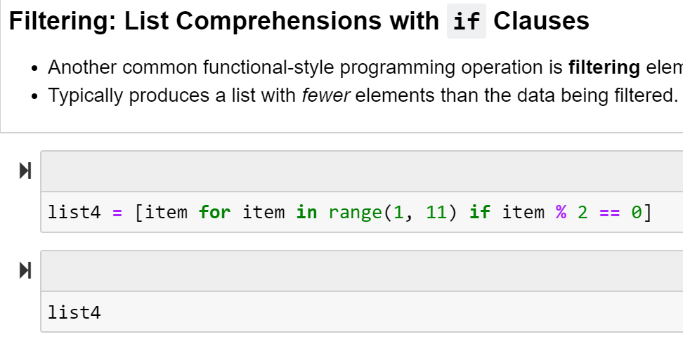
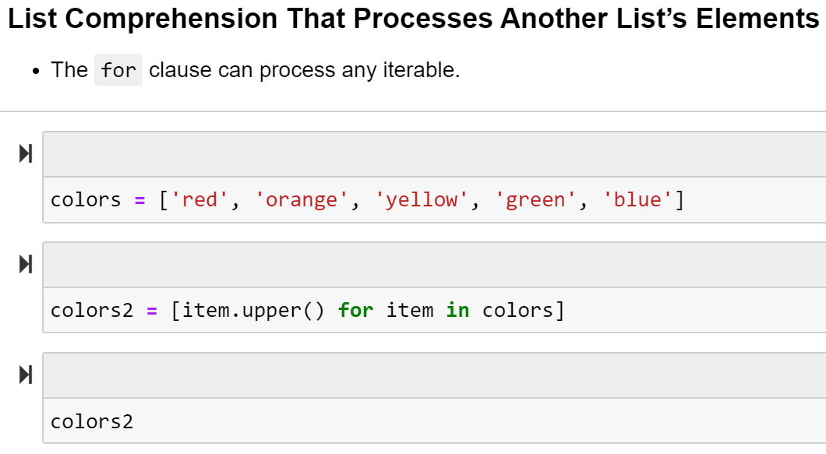
List comprehension

Slide 28
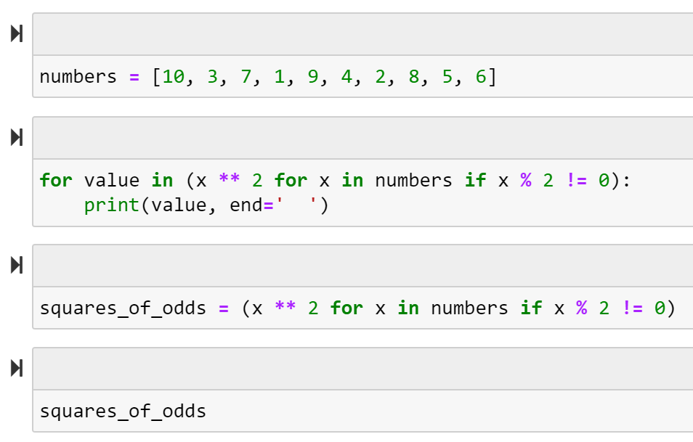
Generator Expression / Lazy Evaluation

Slide 29
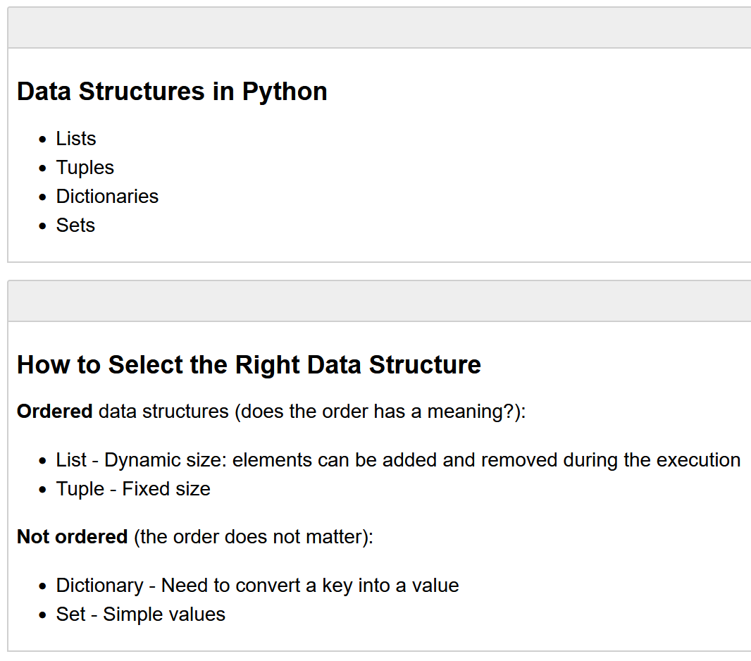
Introduction to Python:
1.6
Summary in Lecture Slides
To read up

Slide 30
Exercises 4a & 4b:
Let’s solve the exercise together…
…to enable you to solve the assignment on your own!

Slide 31
Short “summary” of Coding Python in 7 Slides
Let’s take a look at the slides from last week and what is still open.

Slide 32

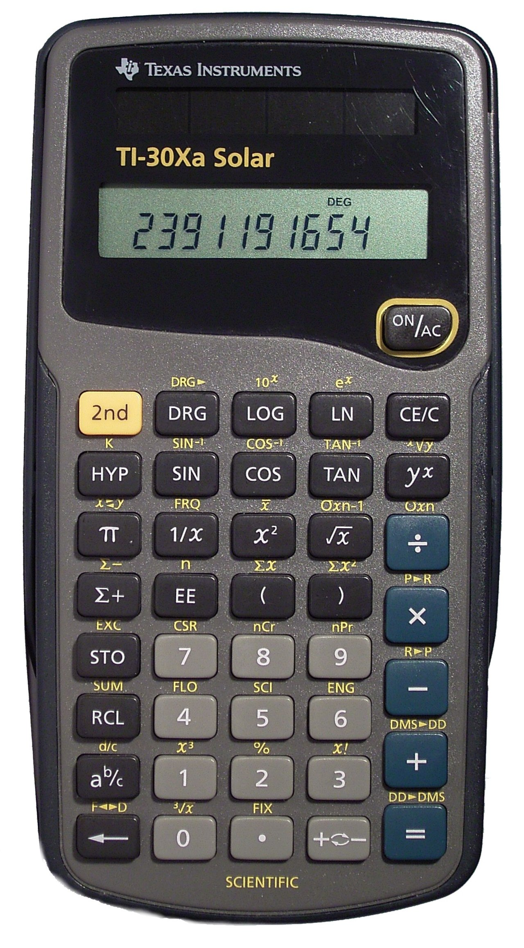
Introduction
A Simple Calculator as your first computer program!
You will learn how to assign values to variables and to do basic calculations
There are among others the following arithmetic operations in Python:
Addition: +
Subtraction: -
Multiplication: *
Division: /
Power Function: **
Example: 3**2 = 9 same as 3^2 (often written like that in Excel)
Modulo Function: %
In computing, the modulo operation returns the remainder of a division, after one number is divided by another (called the modulus of the operation)
Example: 17 % 5 = 2 (15/5 = 3 → the remainder up to 17 is 2)
So, Modulo does integer divisions and returns the remainder

Slide 33
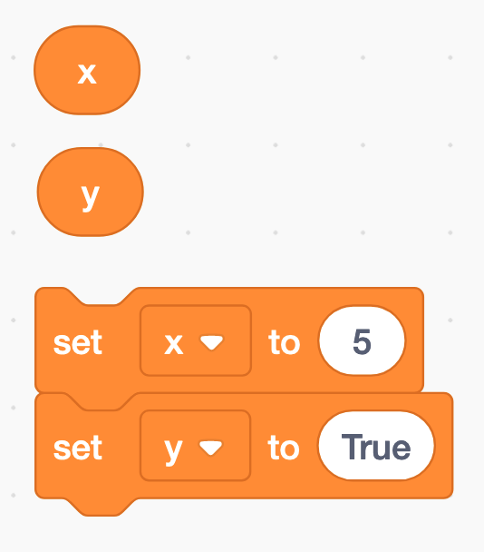
Assigning a value to a variable
The equal sign (=) is used to assign values to variables
x = 5
y = True
etc.

Slide 34
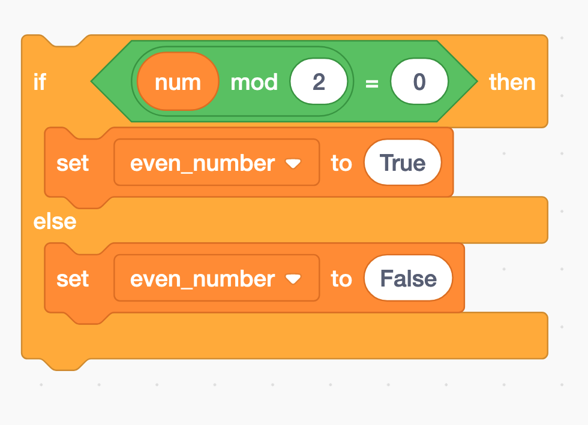
Modulo and if-statements (1)
if num % 2 == 0:
even_number = True
else:
even_number = False

Slide 35
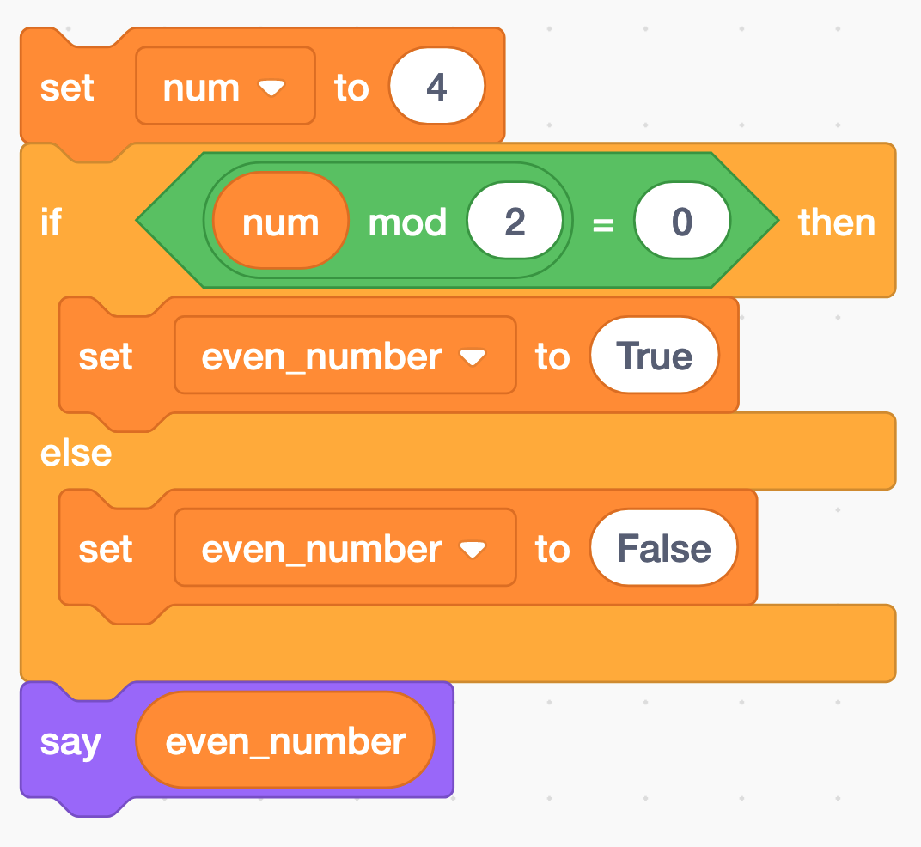
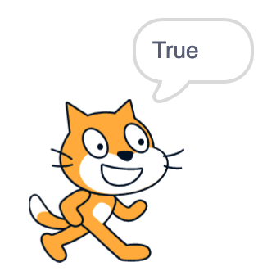
Modulo and if-statements (2)
num = 4
if num % 2 == 0:
even_number = True
else:
even_number = False
print(even_number)

Slide 36
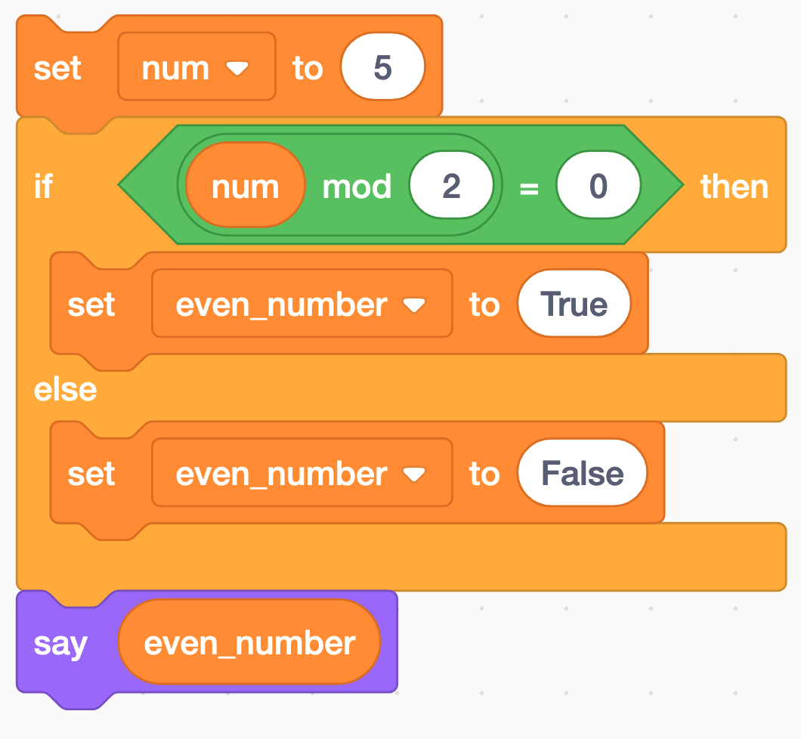
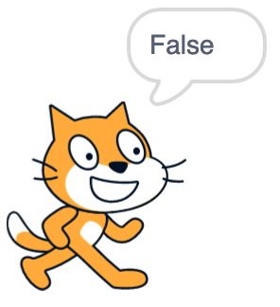
Modulo and if-statements (3)
num = 5
if num % 2 == 0:
even_number = True
else:
even_number = False
print(even_number)

Slide 37
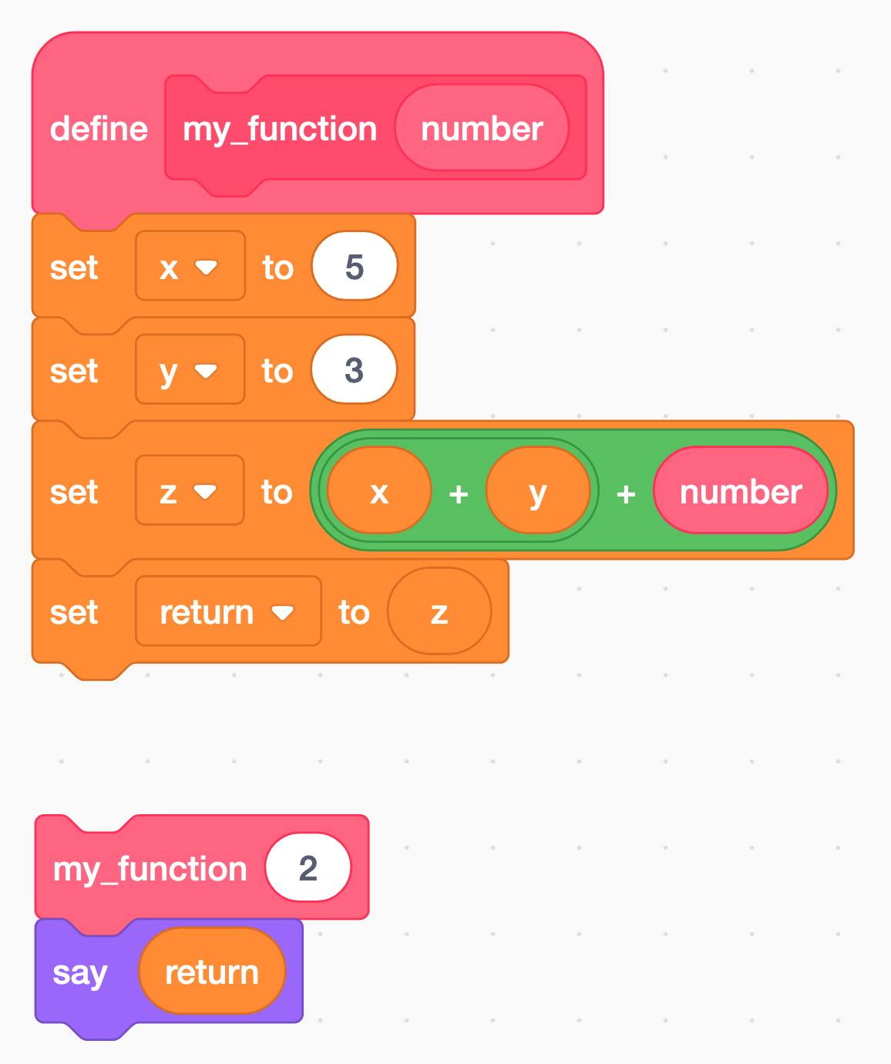
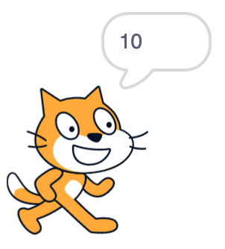
Functions
A function is a block of code that only runs when it is called by its function name
You can pass data, known as parameters, into a function.
A function can return data as a result.
def my_function(number):
x = 5
y = 3
z = x + y + number
return z
print(my_function(2)) # this is the function call

Slide 38
Python data types
Python has five standard data types:
Numbers
Sequences (Strings, Lists, Tuples)
Dictionaries
Sets
Boolean
Python sets the variable type based on the value that is assigned to it. Unlike more other languages, python will change the variable type if the variable value is set to another value. For example:
var = 123 # this will create a variable with type integer
var = ‘john’ # the “var” variable has now as type string
type(var) # returns the data type of the “var” variable
var_2 = ‘5’
var_2 = int(var_2) # changes the string variable var_2 to an integer variable (if possible)
int | a = 10 | Integer (whole number)
float | a = 45.67 | (.) Floating point real values
Numbers

Slide 39
Now you have everything you need to start with assignment 4

Slide 40
Dominik Buchegger
dominik.buchegger@student.unisg.ch

